Slide 1
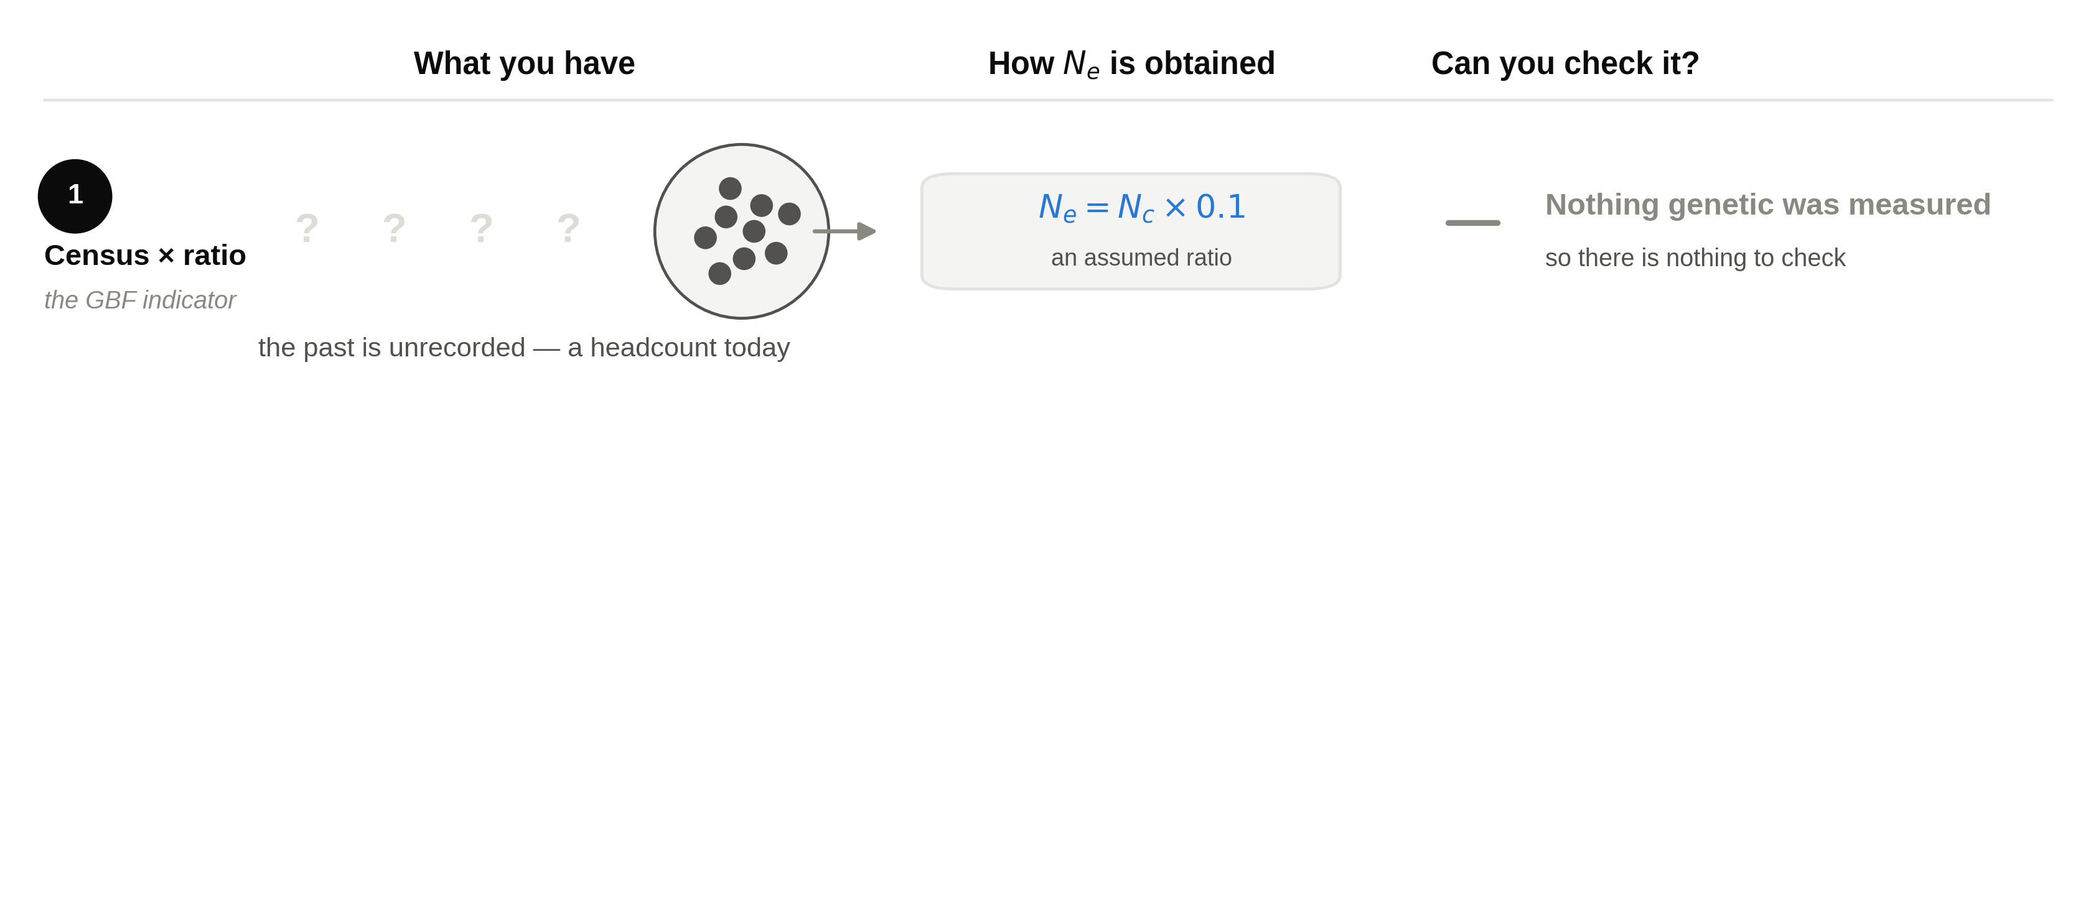
Three ways to get a number for Ne

Slide 2
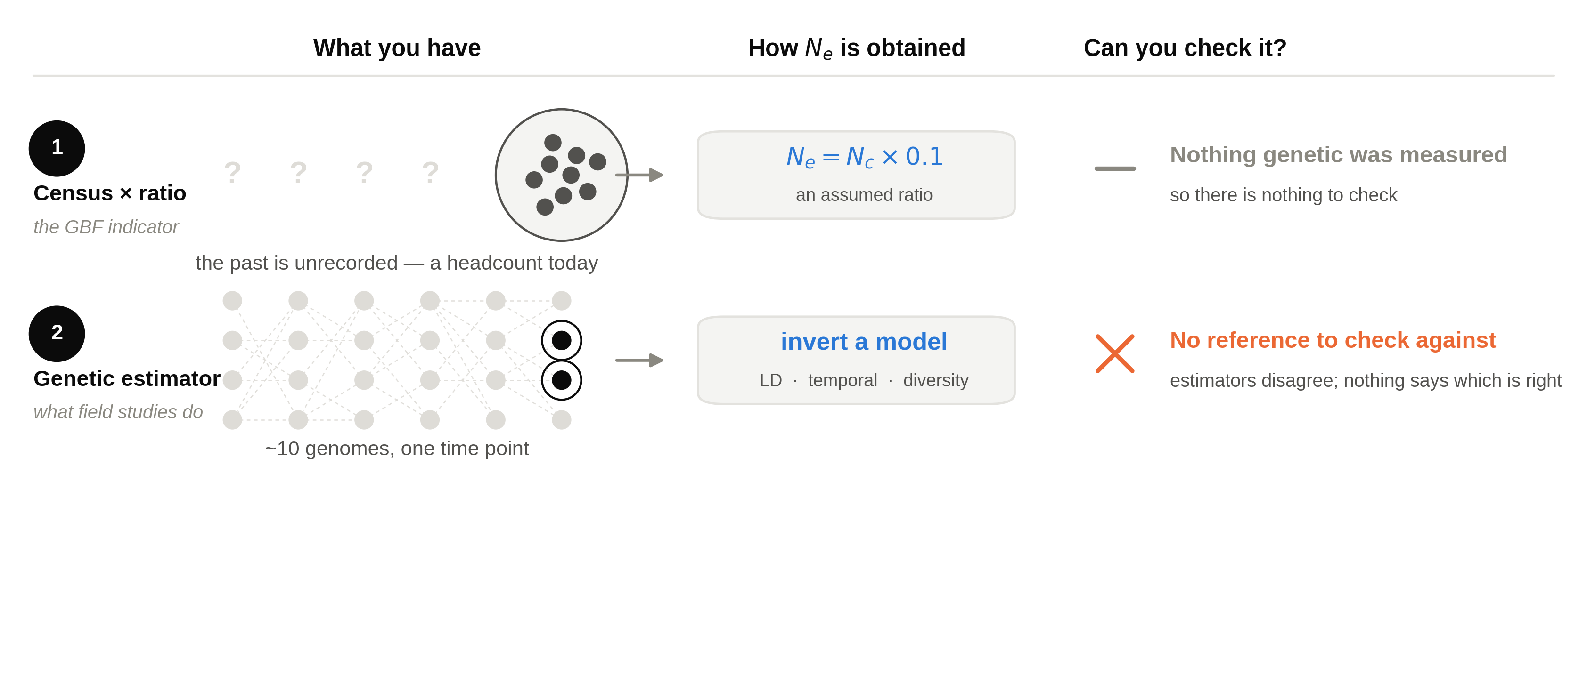
Three ways to get a number for Ne

Slide 3
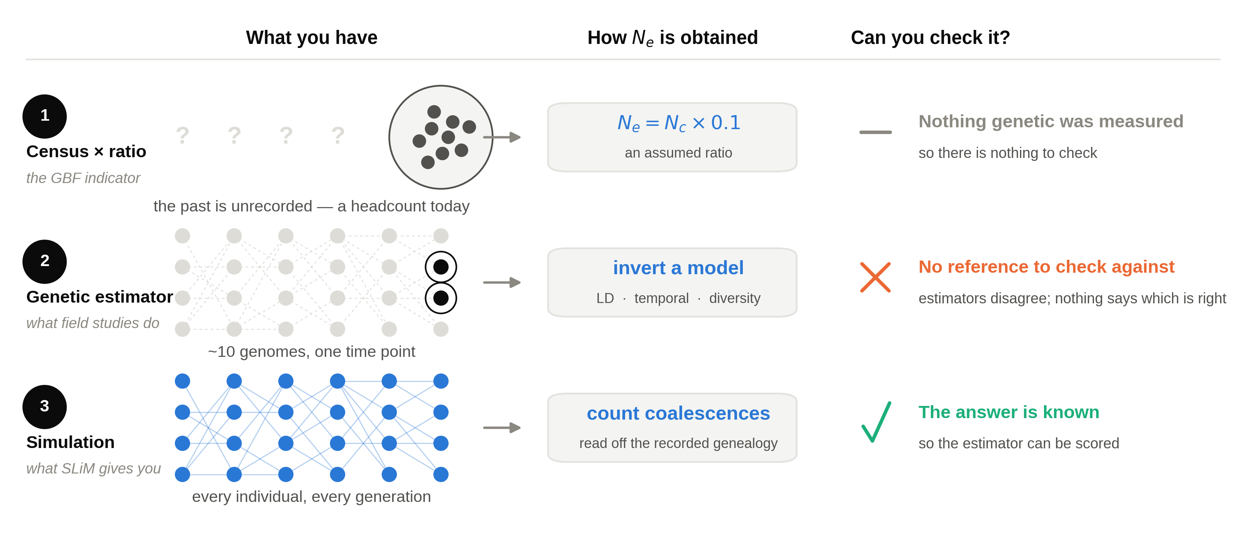
Three ways to get a number for Ne

